Slide 1
Game-Changing
Extended Stability & Sterility, Vacuum-Sealed Drug & Vaccine Delivery System
The Solution to the High Cost and Inaccessibility
of Life-Saving Medications
Contact
Prof. Boris Zubry, MSME, MBA
Chief Executive Officer, Founder & MIST™ System Inventor
bzubry@avicenna-tt.com
+1.732.329.0189
www.Avicenna-tt.com
February 2025
www.Avicenna-tt.com

Slide 2
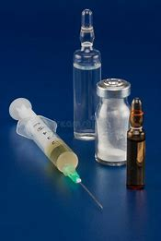
HEALTHCARE COST
The present healthcare cost primarily consists of the manufacturing cost of drugs, ingredients, packaging, storage, shipping and handling, availability, medical devices, medical disposal, and injection (cost of medical professionals).
The healthcare cost has reached the limits and bypassed them. Something has to be done.
One of the solutions proposed by the industry was to convert as many injectable drugs as possible into a prefilled format to allow more injections at home and to combat the cost of injection, storage, handling and shipping, and medical waste.
The industry is also searching for a solution to the high manufacturing cost of drugs. One of the acknowledged solutions there is a new type of prefilled syringe.

Slide 3
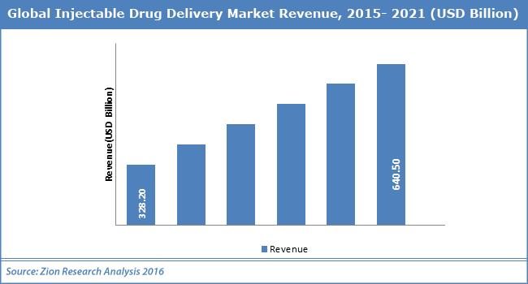
Market Situation
The global life sciences market outlook from 2010 to 2025 shows a range of therapeutic agents (vaccines, insulins, analogues and other biologics) driving growth in the injectable and pre-filled syringe market sectors.
The current basic syringe design (plunger and barrel) used in most pre-filled syringe formats limits the stability dating of inherent drug. This results shortened manufacturing runs (batches), unnecessary downtimes and restricts distribution capabilities.
Health Care market pressures to maintain costs (shipping, storage, handling) and increase care are significant.
Weighty global environmental impact pressures (medical waste).
Based on a 2016 forecast by Zion Research Analysis*, the global injectable drug delivery market revenue will climb to $640-$650B by the year 2021. in 2025, it is over $900B, close to a Trillion dollars.
*https://www.grandviewresearch.com/press-release/global-injectable-drug-delivery-market).
www.Avicenna-tt.com

Slide 4
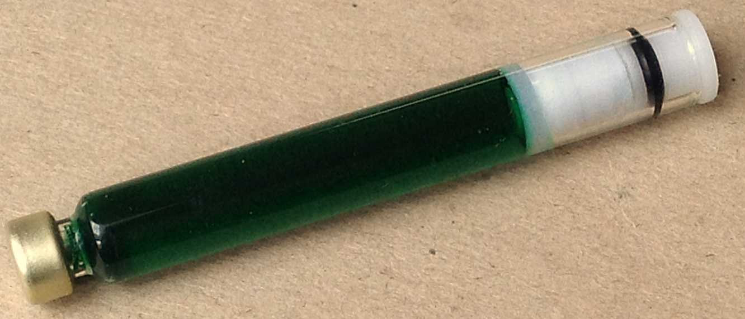
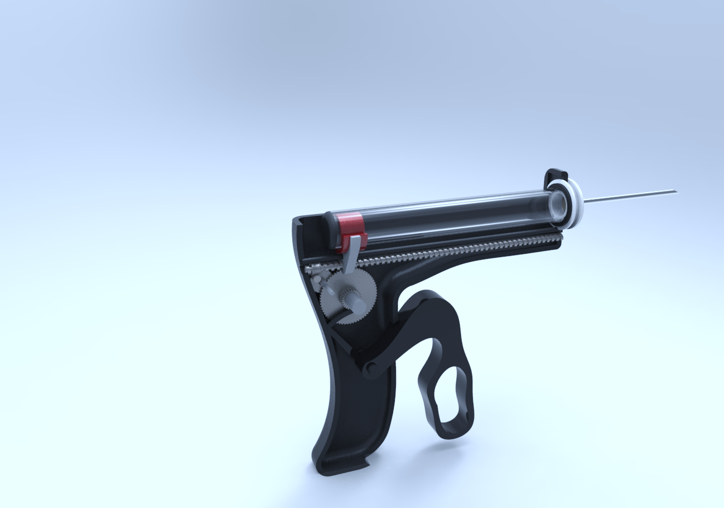
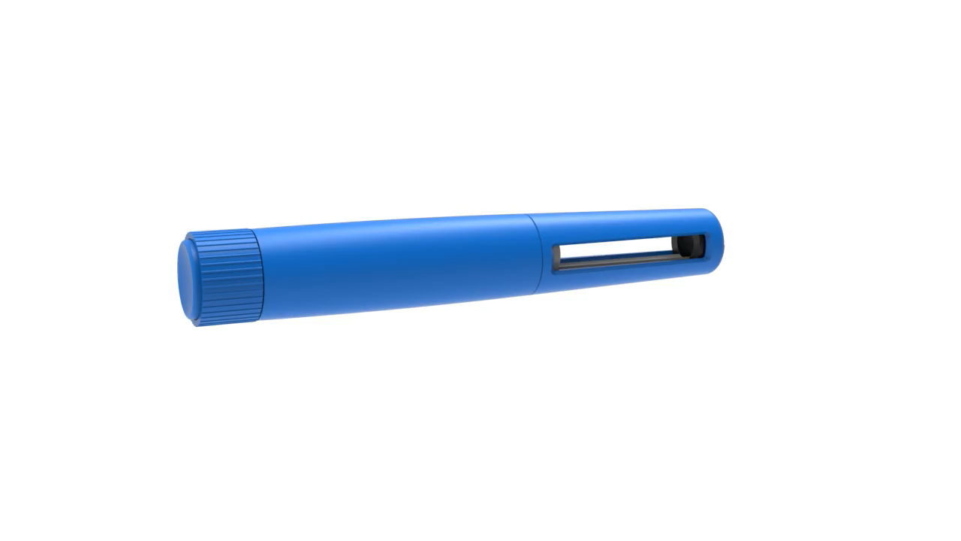
The Invention - Solution
The Patented Avicenna Magnetic Injection Storage Technology (MIST™)
2-Part System
  Vacuum-sealed cartridge that doubles as a disposable plunger-less syringe and storage device containing a Teflon-encapsulated ferrous piston.
  Reusable injector with a movable magnet and a trigger mechanism. Injectors can be custom design for any look.
Simple To Use
  Cartridge is placed into the reusable injector, where magnetic forces cause the ferrous piston to move when the trigger mechanism is operated
  Liquid is expelled or impelled from/into the cartridges through an attached disposable needle.
Game-Changing Engineering
  Can be vacuum-sealed or nitrogen-filled, stores medication for extended periods of time, can store liquids, suspensions, creams, ointments, and caseous compounds, and operates in both directions,
Will compete with existing pre-filled syringe and syringe-vial/ampoule formats on the market today.
www.Avicenna-tt.com

Slide 5
Value Proposition
Versus existing pre-filled syringe formats
Substantially Reduces…
Improves…
Increases…
Cost of manufacturing, filling, shipping, handling, packaging and cold storage
Packaging footprint size*
  Even greater reduction when compared to existing syringe/vial/ampoule formats
Shipping restraints imposed by cold storage and breakable materials requirements
Leachable & extractable contaminants (minimized
or eliminated)
  Decreases possibility of
  cross-contamination
Disposable components
(“greener technology”)
Product stability and sterility
  Extends stability and shelf life
  Improves drug availability
Therapeutic potency
Syringe filling precision (bubble-free technology)
Accuracy of unit dosing, which can positively effect efficacy
& compliance
Storage, handling and shipping
Accessibility of new markets
Environment
The availability of life-saving medications & vaccines anywhere in the world
Profit margins
Environmental “friendliness”
MIST™ increases drug stability, therefore driving down the cost of manufacturing, increasing profit margins, eliminating or reducing cold storage requirements, expanding distribution capabilities to patients in remote areas and reducing environmental waste impact.
*Estimated reduction in packaging: 4-to-10-fold
www.Avicenna-tt.com

Slide 6
Value Proposition (continued)
Substantial Profit Margin Opportunity
~30% reduction in costs
Current “Plunger-Barrel” System
Avicenna MIST™ System
www.Avicenna-tt.com

Slide 7
About the inventor…
Professor Boris Zubry, MS Mechanical Engineering, MBA
40 years of food, cosmetic and pharmaceutical industry experience:
  Injectable packaging and manufacturing
  Engineering
  Capital project management
  Operations
Post-secondary teaching education experience:
  Community College of Philadelphia
  Rutgers University
  Rider University
  Rowan University

Slide 8

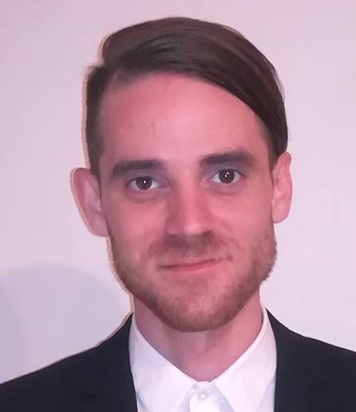

Our Team
Driven by Robust Engineering
to POC in 1 year
Avicenna Therapeutic Technologies has developed a novel, patent-protected, plungerless Magnetic Injection Storage Technology (MIST™) that addresses many of the challenges and problems associated with other pre-filled syringe and syringe/vial/ampoule formats.
Boris Zubry
Inventor & CEO
Liviu Barbu
Advisor
Konstantin Caploon
Advisor
Increases accessibility, profit margin potential & reduces environmental impact
www.Avicenna-tt.com

Slide 9
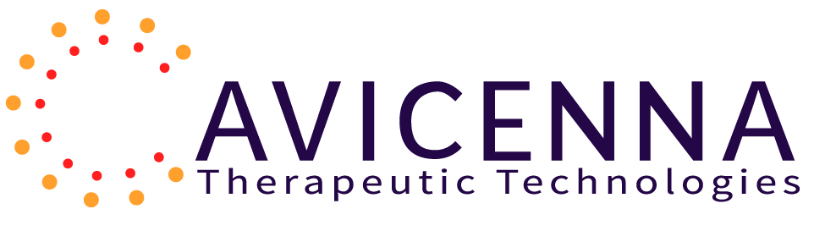
Opportunities
We’re seeking capital and to partner or enter into agreements with pharmaceutical, biotech, specialty-pharma, medical device,
and vaccine manufacturing companies, as well as syringe manufacturers for the use of Avicenna’s MIST™ System.
We are looking for an equity investment of $5 M, which is needed in stages of $1 M each. My evaluation of the company at the time is about $8 M to $10 M. The exit strategy is an IPO or purchase by a bigger player in the industry. I do not have the Board and would welcome the creation of it and you joining it.

