Slide 1
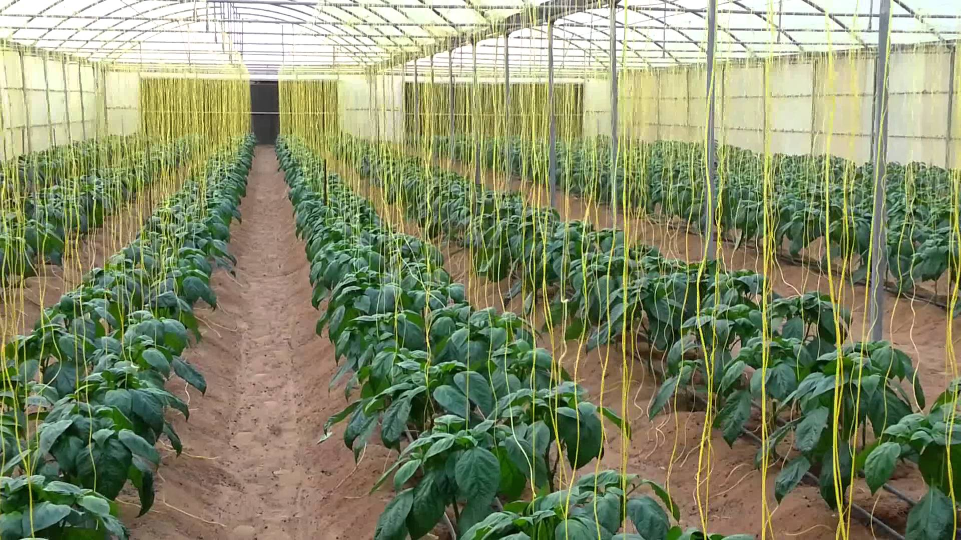
Increasing the efficiency of the greenhouses cooling for agriculture in dry hot areas
Using
Invented Indirect Evaporative Air Cooling

Slide 2
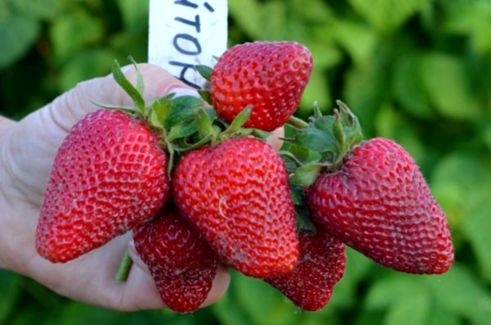
Presentation Submitted to
ابتكارات المملكه
King Saudi Arabia Eptikarat

Slide 3
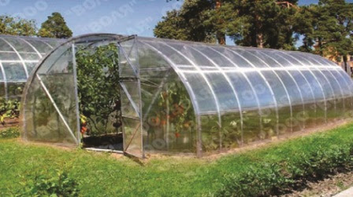
Developing the cooling efficiency and distributing in greenhouses

Slide 4
Registered Patent, Submitted to WIPO International under the number
PCT / SD 2019 / 000003
Searched by European office ISA/EP, Published by WIPO
https://patentscope.wipo.int/search/en/detail.jsf?docId=WO2020251424&_cid=P20-KIU2CX-63507-1

Slide 5

Local and international certificate

Slide 6
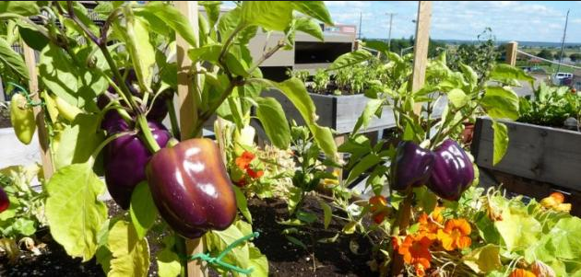
Invented and designed by
Hussein Ibrahim
BSC Honor Agricultural Sciences
University of Gezira , Sudan
BSc Water sciences From UNESCO chair Institute, Inventor and Founder of www.zebraagricultural.com

Slide 7
Horizontal Air Cooling
Objectives
By Adding
1/ Horizontal Cooling Pad.
2/ Turbo Fans for obtaining air and aeration.
3/ Adding Air Paths for heat exchange .
4/ Air distributing by connecting Air bag to the horizontal cooling pad air path.
5/ Adding copper air path partition under the horizontal cooling pad.
6/Adding copper wires in-between air paths partition

Slide 8
State of the Problem
Low Cooling Capacity in the Traditional design.
Low Evaporative Efficiency.
No Heat Exchange with the outside environment.
No Aeration to the vertical cooling pad
Small evaporative surface (Vertical Cooling Pad ).
No Turbo Fans For heat exchange .
Poor Air Distribution inside the greenhouses
Different Value of cooling in the front of the greenhouse,
Low Production.
No full Capacity,

Slide 9
Invented Concepts & Principles
Horizontal cooling pad for
Extend the evaporation surface
Aeration and heat exchange with outside environment and heat exchange mechanisims
Helps air to penetrate through the horizontal cooling pad (Pushing air in ).
Fogging Nozzles For Distributing foggy on the surface of H.C.P
Copper air paths partitions and copper wires for indirect cooling

Slide 10
Methodology
Constructing Pilot Model With the New Concepts
(Vertical cooling pad + Horizontal Cooling Pad + Watering of the both cooling pads + fixing turbo fans controlled by senses).
Functioning the Greenhouse pilot model under the New concepts & principles.
Connecting heat sensors and Relative humidity senses to to read the data outside and inside (Bulb Tm )
Collecting Data through the time of the experiment.
Sorting Data
Analyzing Data ,

Slide 11
For Example
Using evaporative cooling, exhaust air at a temperature between 24 und 28°C and humidity of 95% RH can be cooled down by approx. 9 K (exhaust air humidity 30%) or approx. 5 K (exhaust air humidity 60%). The drier t
Dry Temperature
Wet Temperature
Bulb Tm
Relative Humidity

Slide 12
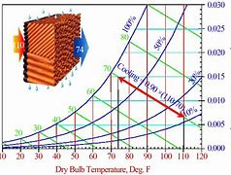
Applying Data to

Slide 13
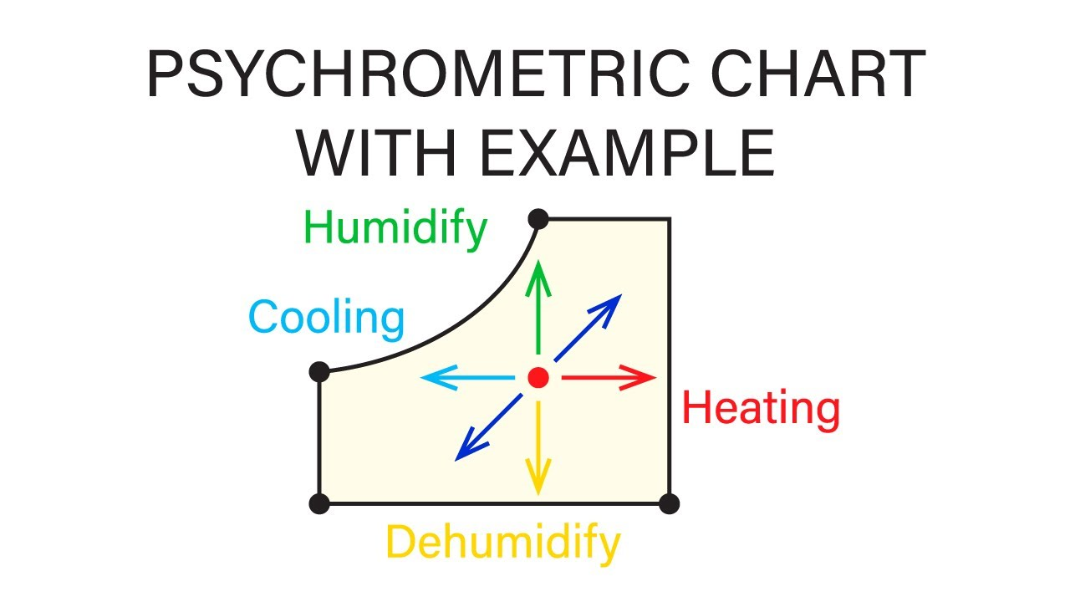

Slide 14
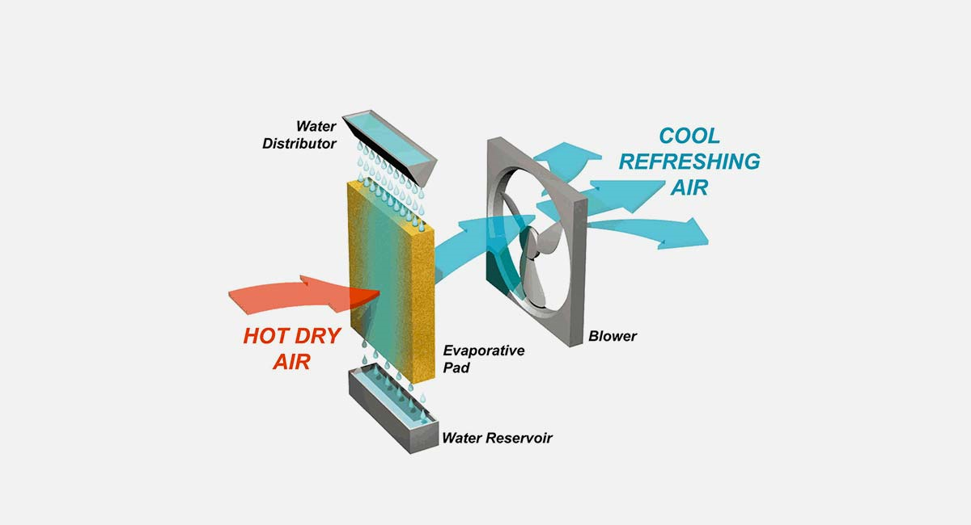
Vertical cooling pad alone

Slide 15
1. Introduction
Saudi Arabia is classified as arid and semi-arid area .according to the geographical location in the desert of Middle East. Where heat and dryness dominate the daily climate through the majority months of the year, the variation of the heat degrees between day and night known as desert climate, all together generate heat stresses for people, Agriculture and animal and restricting some plant varieties to grow and product, This warrant some kind of artificial environment as closed and semi closed greenhouses and poultry and animals closed farms in order to product the daily consumed vegetables and fruits and import the others from nearest countries. Greenhouses using the evaporative cooling partially solved the problems but still direct Evaporative air cooling has its disadvantages such as huge quantity of water consumption and short in conditioning large places due to it short in cooling capacity in dropping down the heat temperature

Slide 16
The Alternative Indirect air-cooling is more efficient and it has benefits in water and energy consumption saving. The majority uses of indirect air cooling is a big units uses for central cooling in buildings and malls because of it efficiency in offering the comfortable heat and humidity, but it never been used in agricultural sector, that there are no models and designs suit the greenhouses
In this proposal, we are trying to deliver an invented designs and smart model that can suit the already existing greenhouses with only change and modification of the backside of the greenhouses and tunnels without changing in the greenhouses specification, this will encourages the farmers to adopt this benefits of the smart design with low cost and adopting the easy maintenance
Witch will provide the means of flexibility and sustainability, with good opportunities for the researches institution to carry more studies in this field
By using some of modern design and invented patents (Ibrahim, 2018), published by WIPO - international which gives some solutions for using new designs of indirect evaporative air cooling

Slide 17
Discription
4 - The longitudinal chamber contains horizontal longitudinal openings on top of water surface for providing sucked air which is sucked by the main fan from below upwards the external part to the internal part of the device.
5 - This air conditioner has been designed for achieving utmost benefit from internal area available. Manufacturing costs.
6 - A small motor operated fan may be installed in the lower chamber above water level at lower tank for providing positive pressure to upgrade the efficiency of thermal heat exchange between the internal surface and external space.

Slide 18
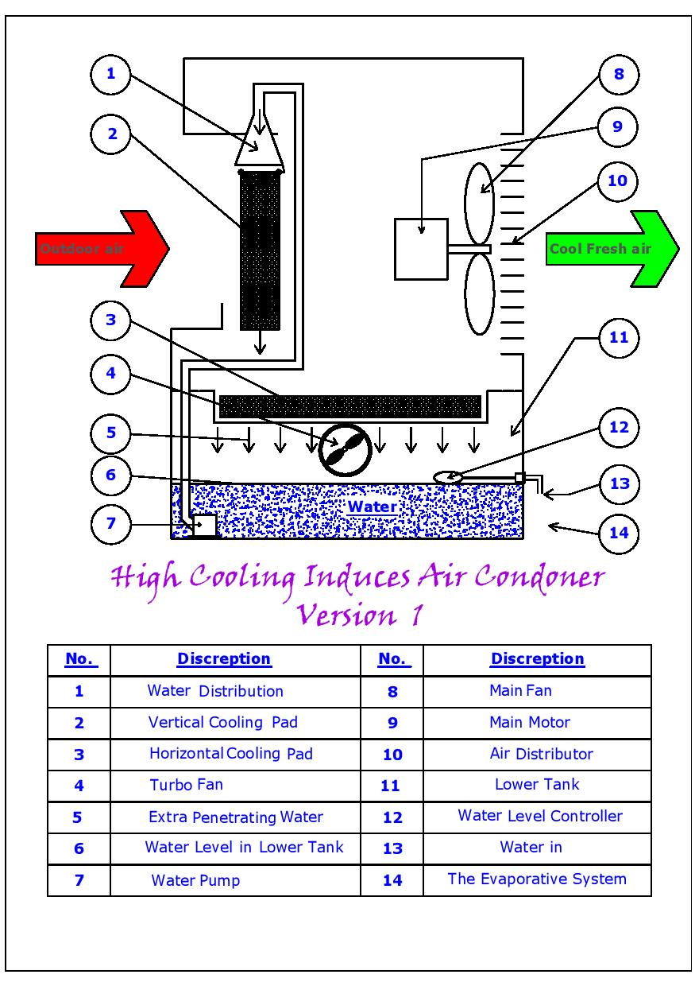
Principles & Concipts

Slide 19
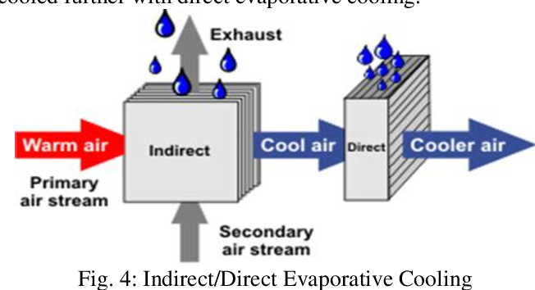
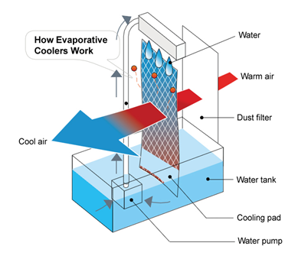
IEAC Vs DEAC

Slide 20
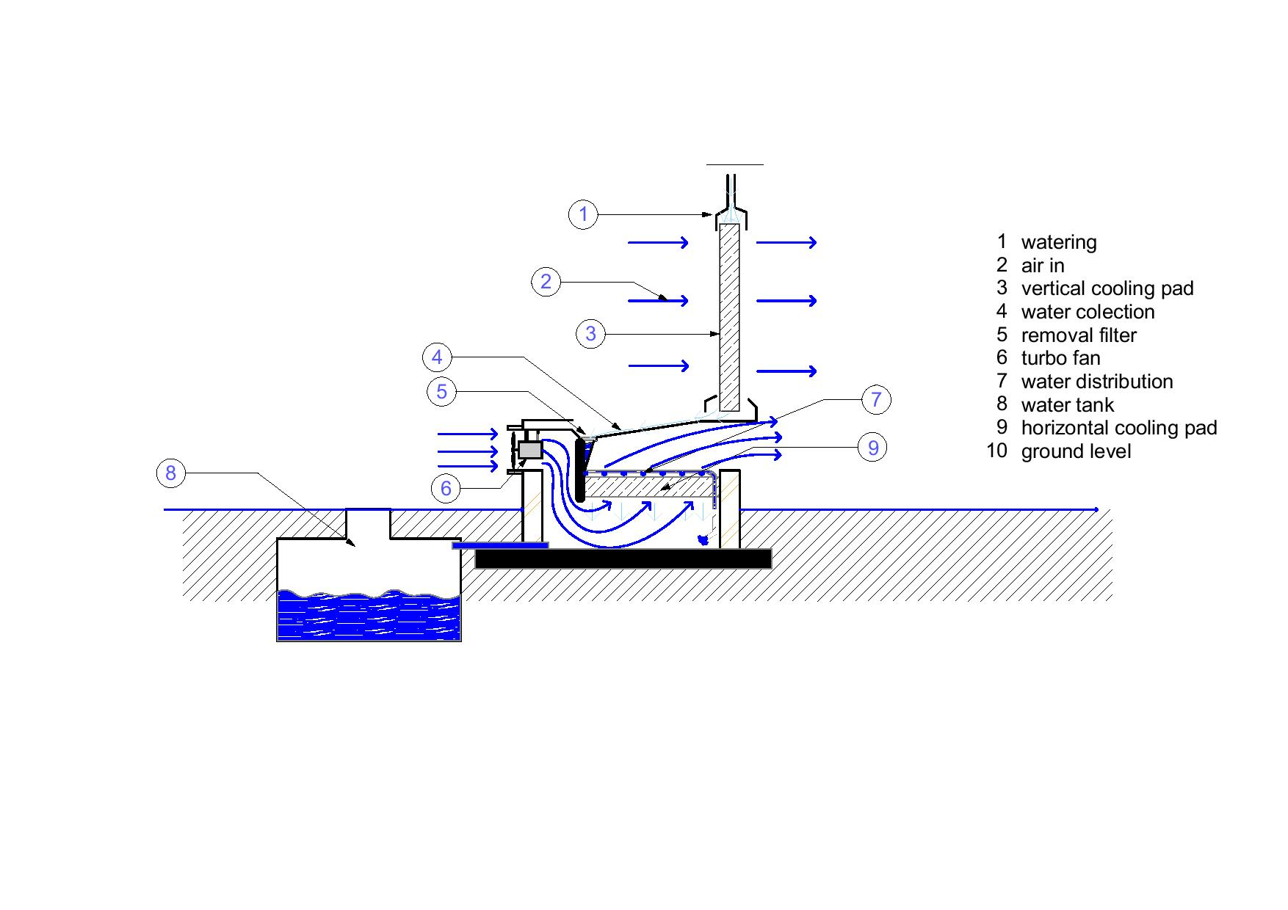
Principles in Greenhouses

Slide 21
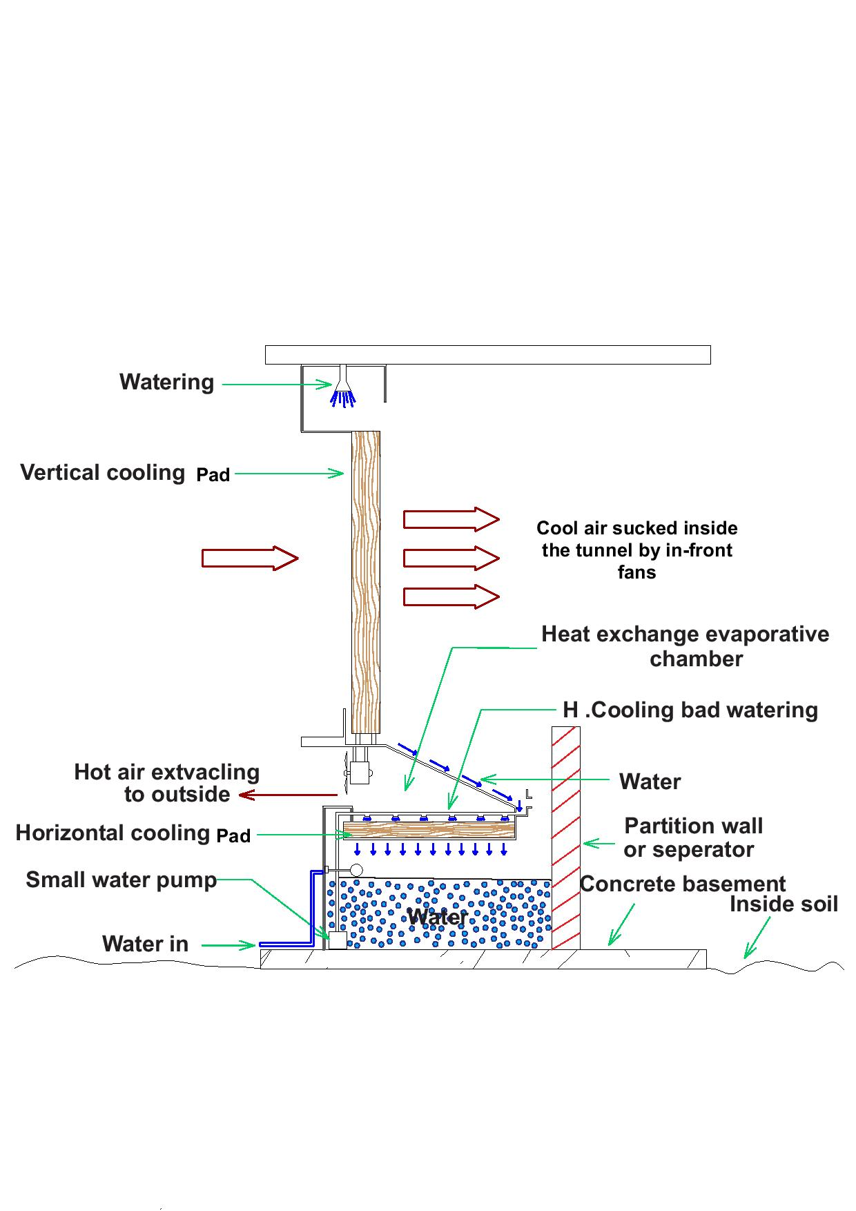
Greenhouses cooling

Slide 22
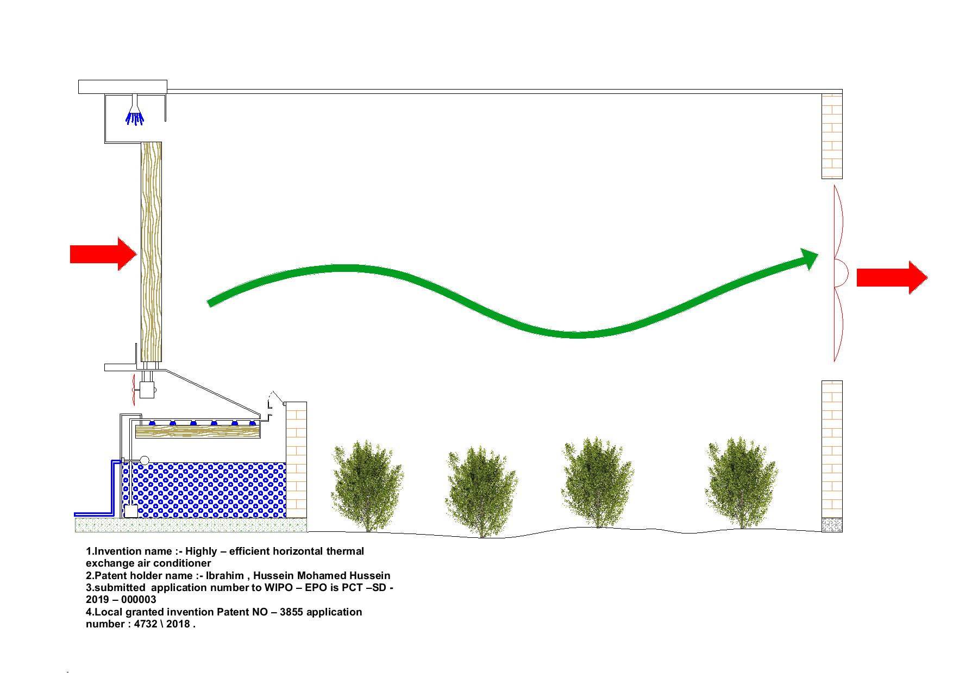
Greenhouses cooling via Hor CP

Slide 23
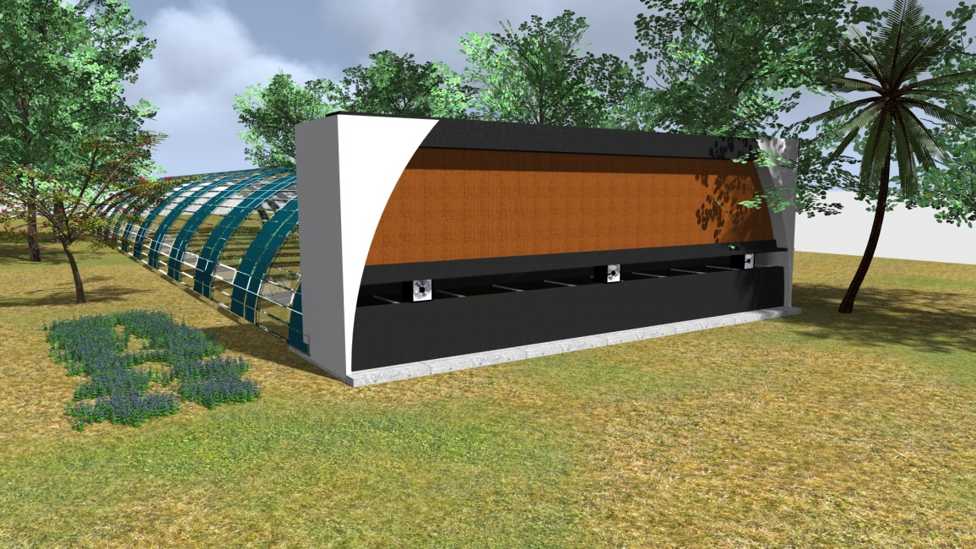

Slide 24
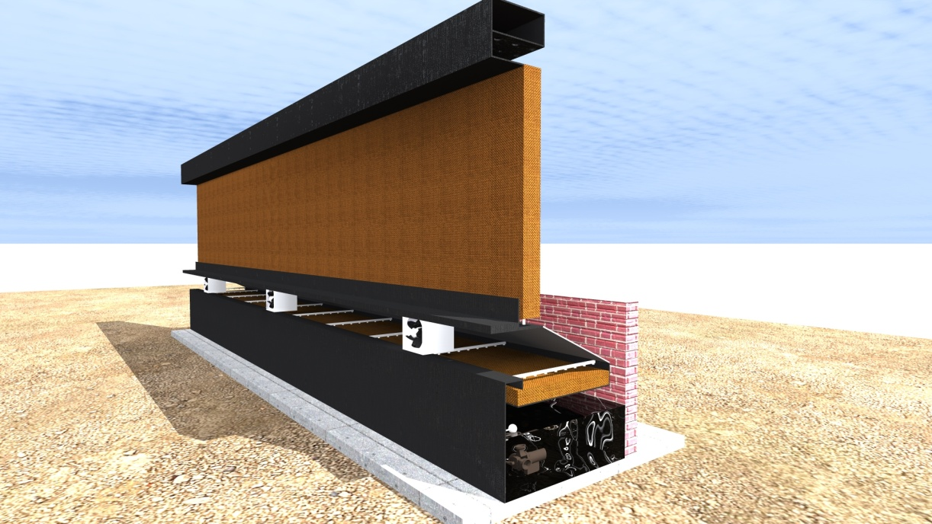

Slide 25
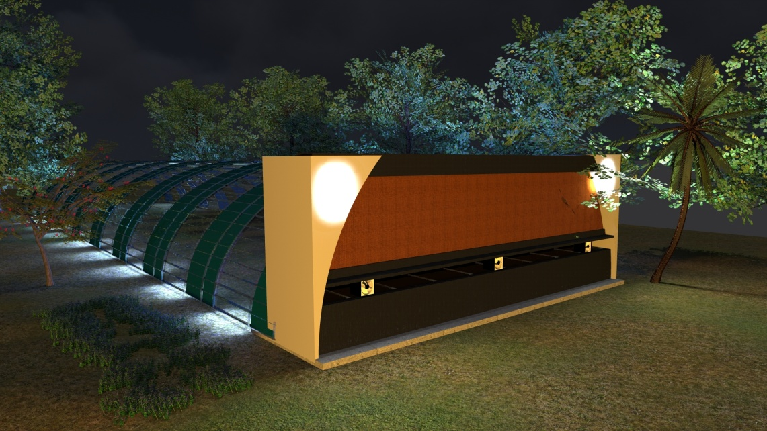

Slide 26
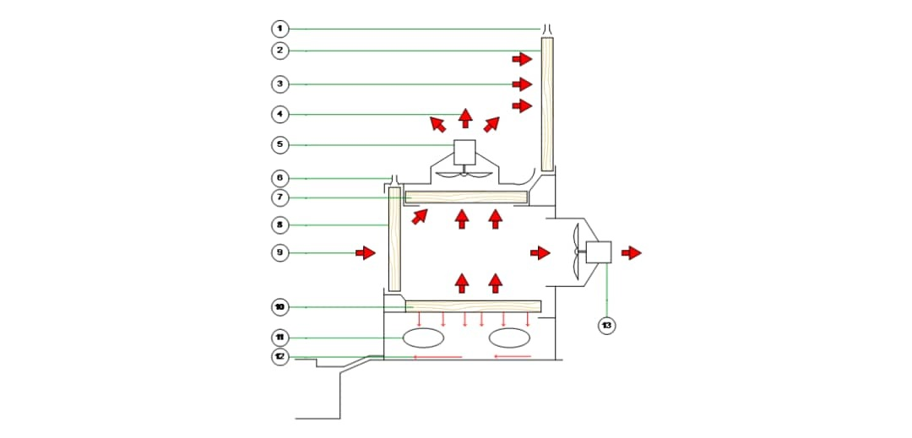
Option 2

Slide 27
1 | Watering system | 8 | Vertical cooling pad B
2 | Vertical cooling pad | 9 | Air in
3 | Outside air in | 10 | Horizontal cooling pad B
4 | Air from outside turbo fan | 11 | Open halls for air in
5 | Small motor | 12 | Water to outside underground tank
6 | Watering system for additional cooling pad | 13 | Inside turbo fan Exhausted
7 | Horizontal cooling pad A

Slide 28
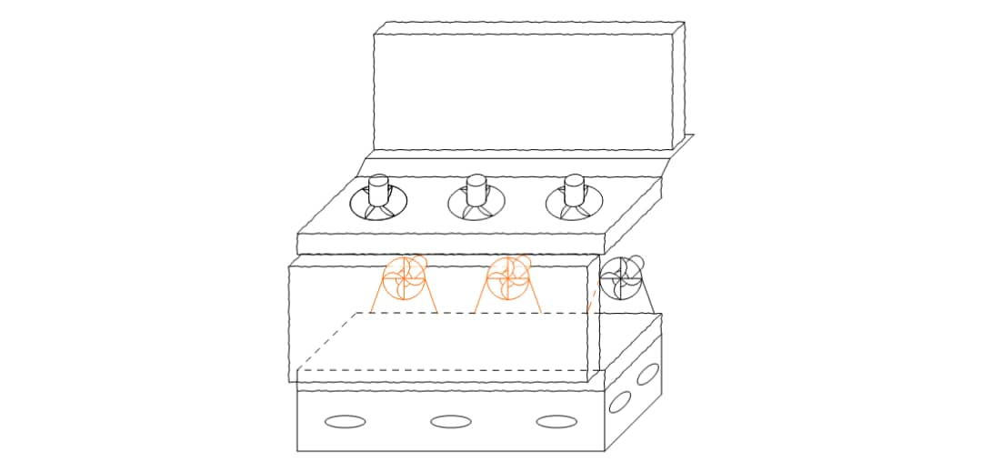
Extra cooling pads and extra turbo fans

Slide 29
Option 2
Using multi turbo fans and multi cooling pads for
Increasing the Evaporation space and then increasing the numbers of exhausted fans with the same greenhouse unit
Apply the heat exchange mechanism
The outside turbo is
70% of the air will penetrate through the vertical cooling pad again and part of the remain air will go outside environment launching the heat exchange mechanism

Slide 30
Conducting a tide strict experiments to determine the heat exchange value that added by the horizontal cooling pad system
Constructing a Prototype for studying and calculate :-
Drop in heat temperature
Relative humidity
To calculate:-
Cooling Capacity
Evaporative efficiency

Slide 31
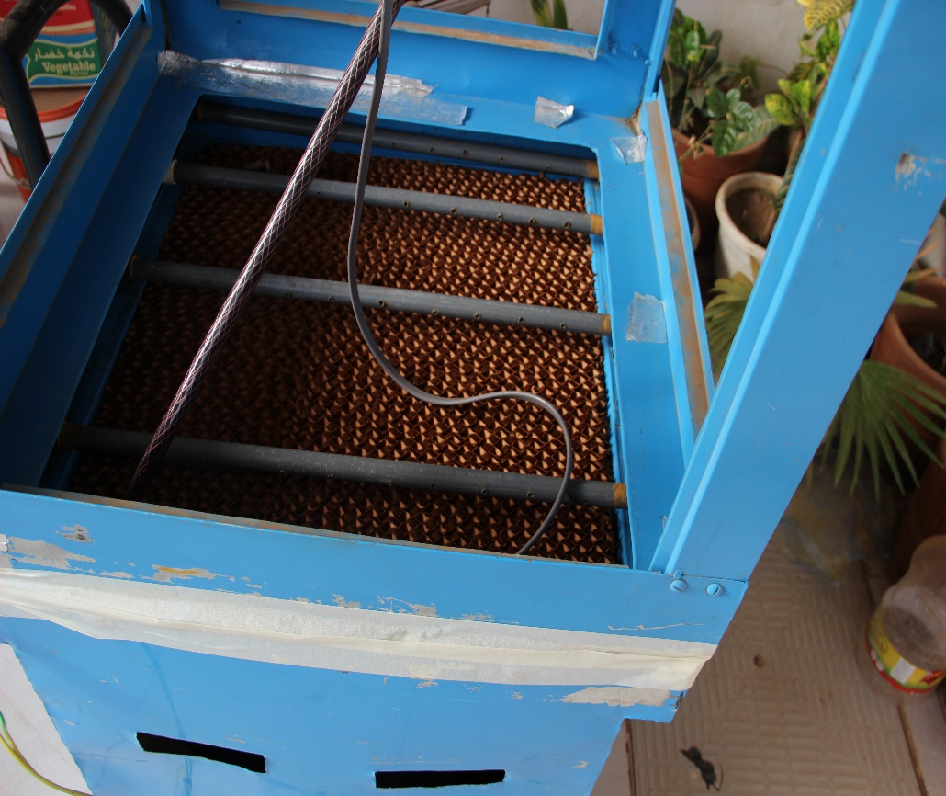
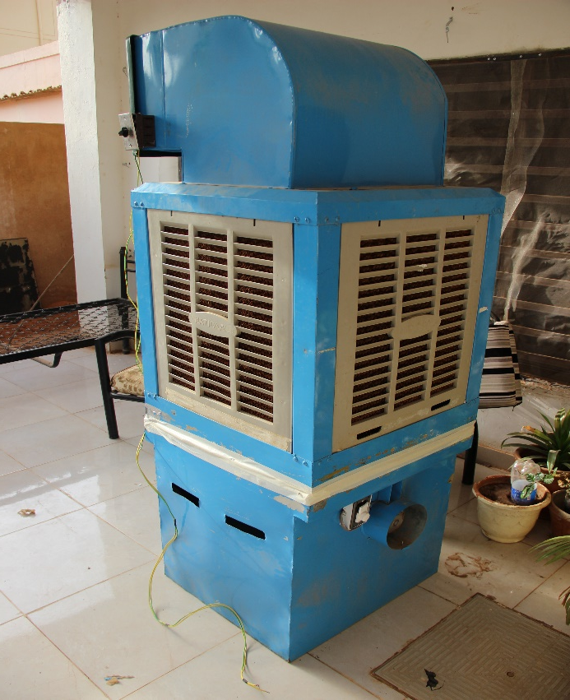
Simulated Prototype was constructed and it has been experimented it gives 2Total 7 C degree decreases in temperature Centigrade degree lower to regular ones total 5 C

Slide 32
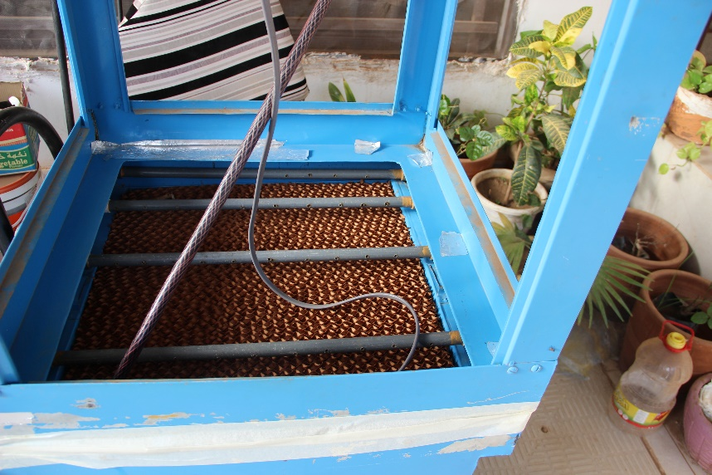
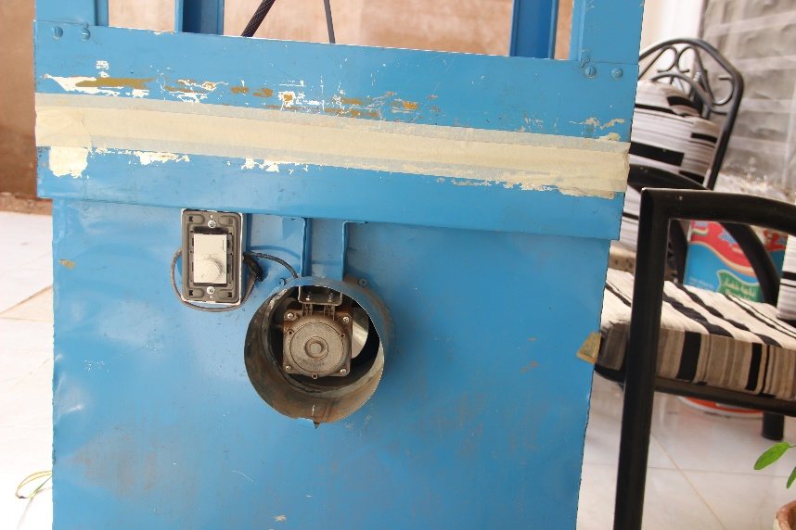
The Horizontal cooling pad
Water distributer
The turbo fan

Slide 33
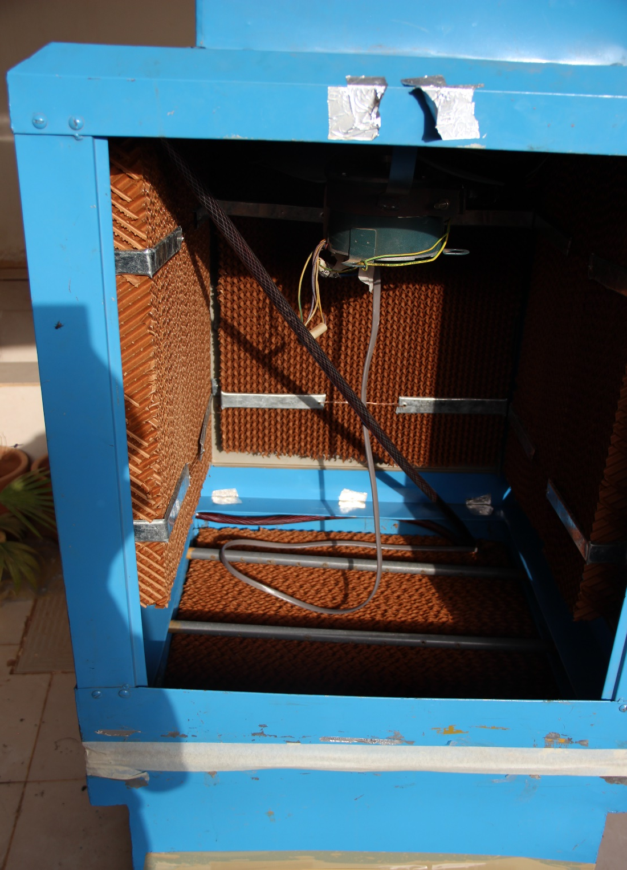
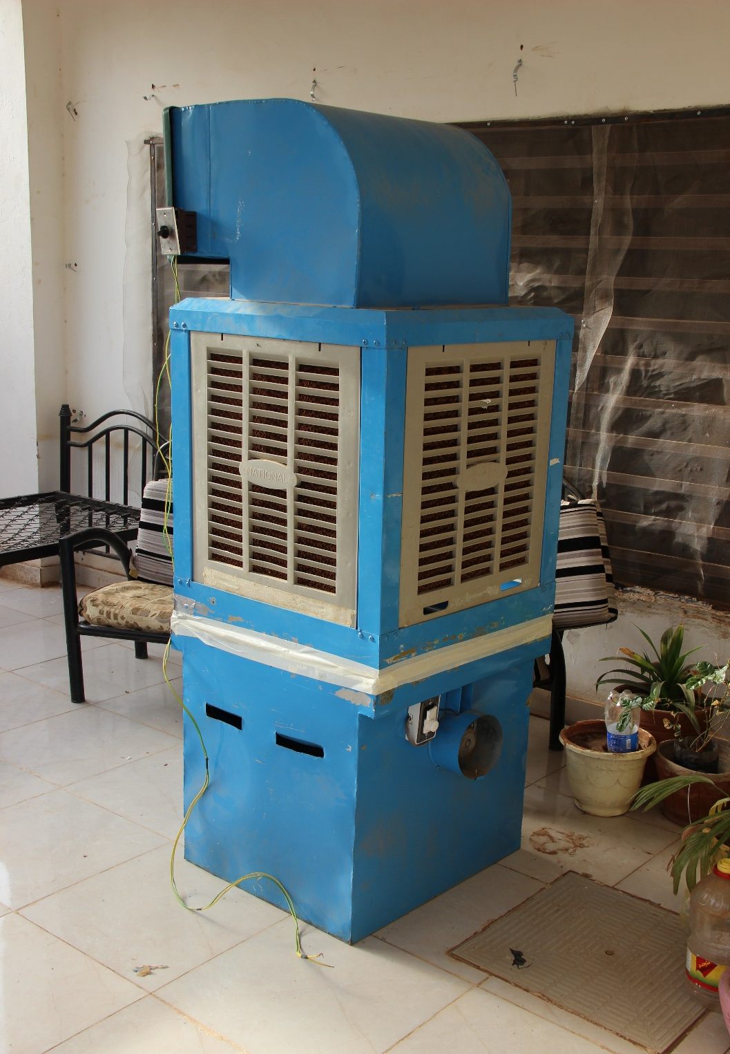

Slide 34
Conclusion and Recommendation
Simulation and modeling prototype
Real scale greenhouse with the new concepts
Developing through conducting an experiments approach

Slide 35
Hussein Ibrahim
Private inventor
Volunteer researcher at University of Khartoum
Other Inventions
Water Purification Unit for Rural Areas
Biological Septic tank for outback areas
Waste water Conservation (Wooden garden Scheme )
Water desalination using energy of sea waves
Contact Information
Whatsapp No-+249 (0) 9 184 08 002
Mobile +966 56 77 31 484 , Riyadh , Saudi Arabia
Emails
hussio777@hotmail.com
hussio6719@gmail.com
hussio67@yahoo.co.uk www.zebraagricultural.com

Slide 36
Hussein Ibrahim
The End
Thank you

