Slide 1
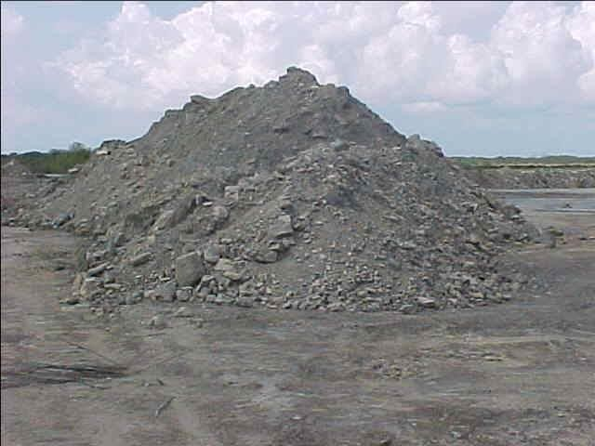
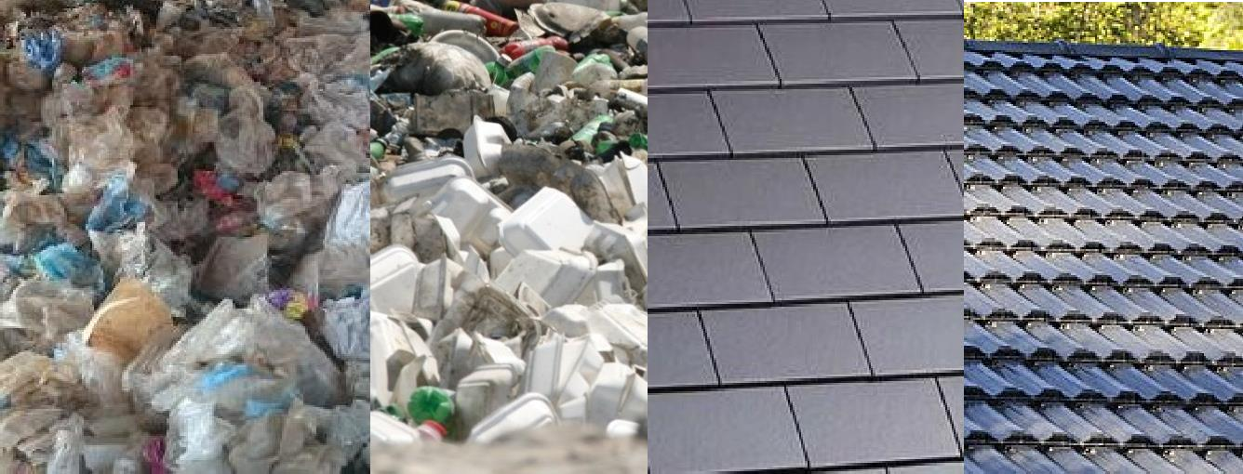
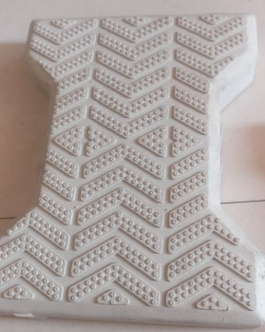
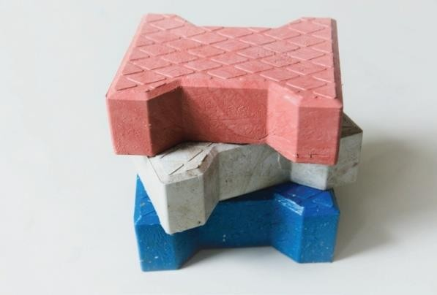
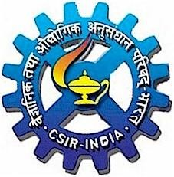
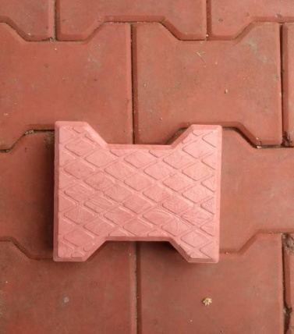
Utilization of Waste Plastic in Designing Tiles for Societal Applications
Dr. S.K. Dhawan
Chairman, Solid Waste Management & Waste Plastic Management Group (CPCB)
&
Emeritus Scientist
CSIR – National Physical Laboratory
(Ministry of Science & Technology, Govt. of India)
Dr. K.S. Krishnan Marg, New Delhi - 110012

Slide 2
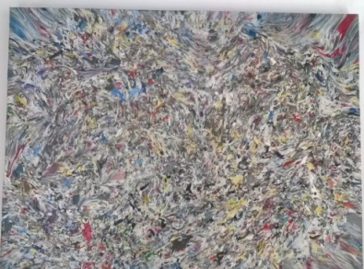




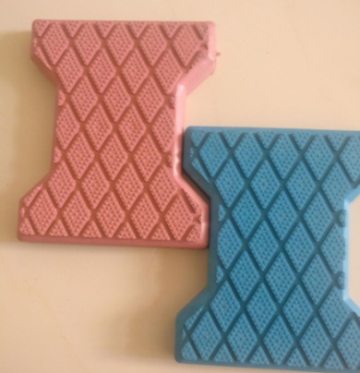




Why Waste Plastic reinforced with flyash Tile Project
& What we planned?:
* The main objective of the our innovation is to utilize
waste plastic scrap & flyash for designing of floor tile, interlock tile, paver tile and roof tile in building of structures and rooms for general public for societal usage.
* Novelty and Positioning of the Work:
Recycling of waste plastics from poly ethylene bags, bottles, and other
containers in the form of a tile, so that these tiles can be inserted in the panels.
The various challenges like mechanical strength, flame retardency, water
premeability and UV- protection from sunlight & antistatic response is the novelty of the concept.

Slide 3
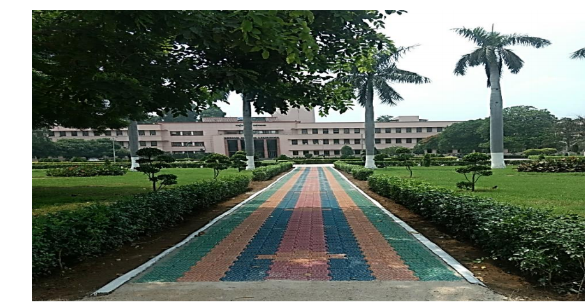
Waste Plastic tiles reinforced with flyash installed at CSIR-National Physical Laboratory

Slide 4
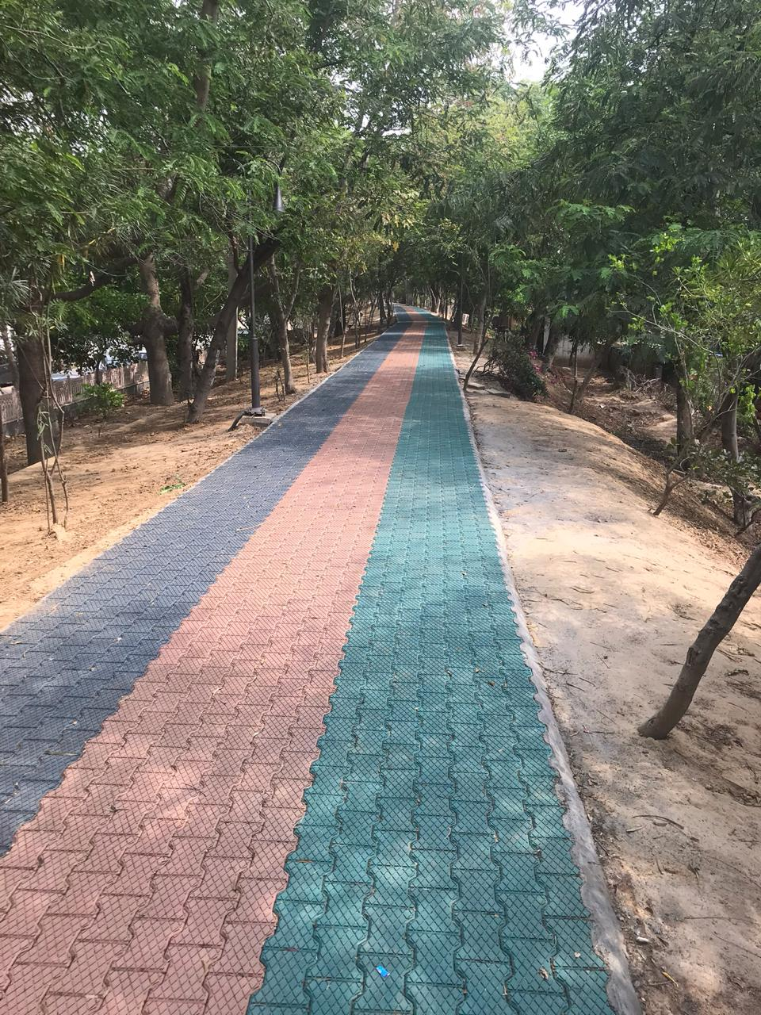
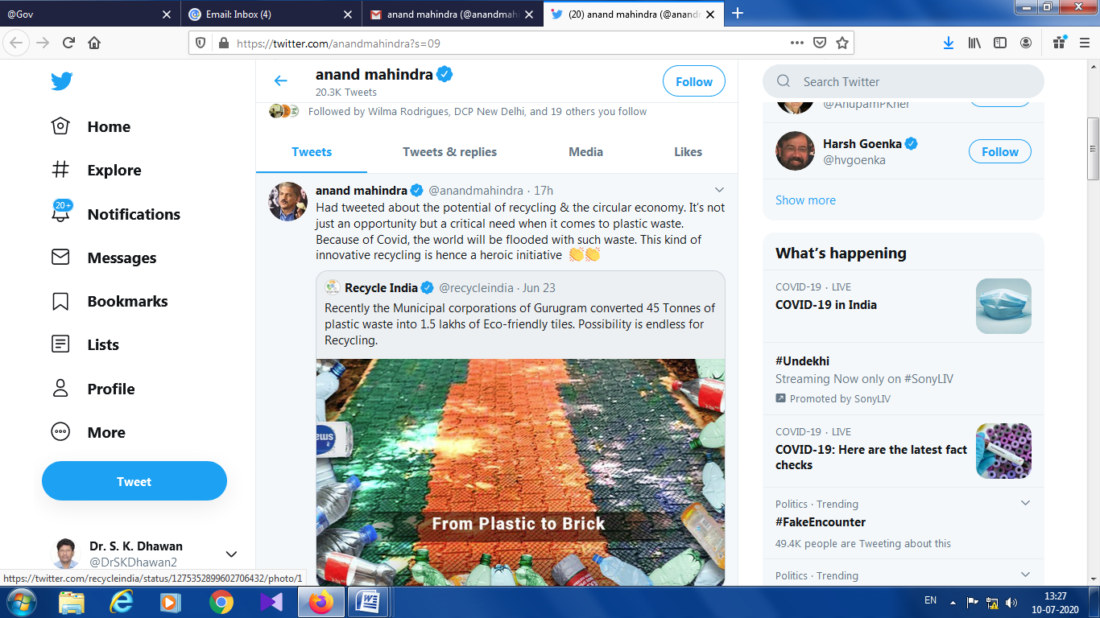
Anand Mahindra has recently twitted about these tiles
Tiles installed at Sector 15, Bandh Area, Gurugram

Slide 5



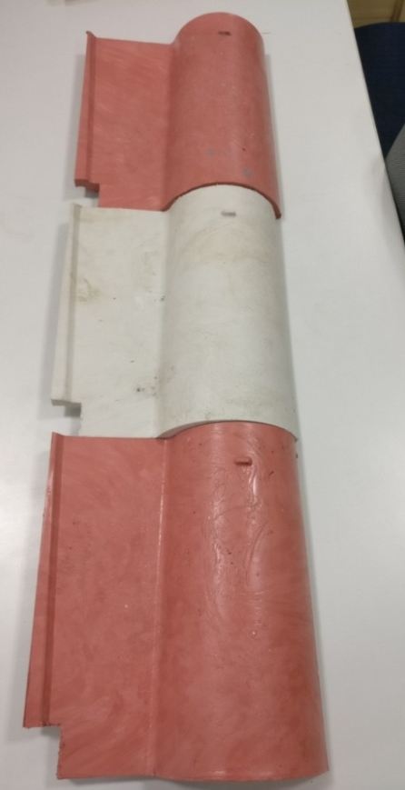


Department of Science and Technology, Government of India in association with IIM Calcutta Innovation Park launched Smart Fifty- 50 solutions to Transform India!
The Smart Ideas from all over India that are Sustainable, Motivating, Affordable, Responsible
and Transformational, participated in India’s biggest funding event.
CSIR - National Physical Laboratory, New Delhi technology on “Utilization of Waste Plastic bags in designing tiles for Societal Usage” (Reg. No. XH101193AX) has successfully made it to Top 50 Innovations in India.
Paver Tile
Roof Tile

Slide 6


